Slide 1
PRINCIPLES OF DESIGN used in
Lr
MOBILE

Slide 2
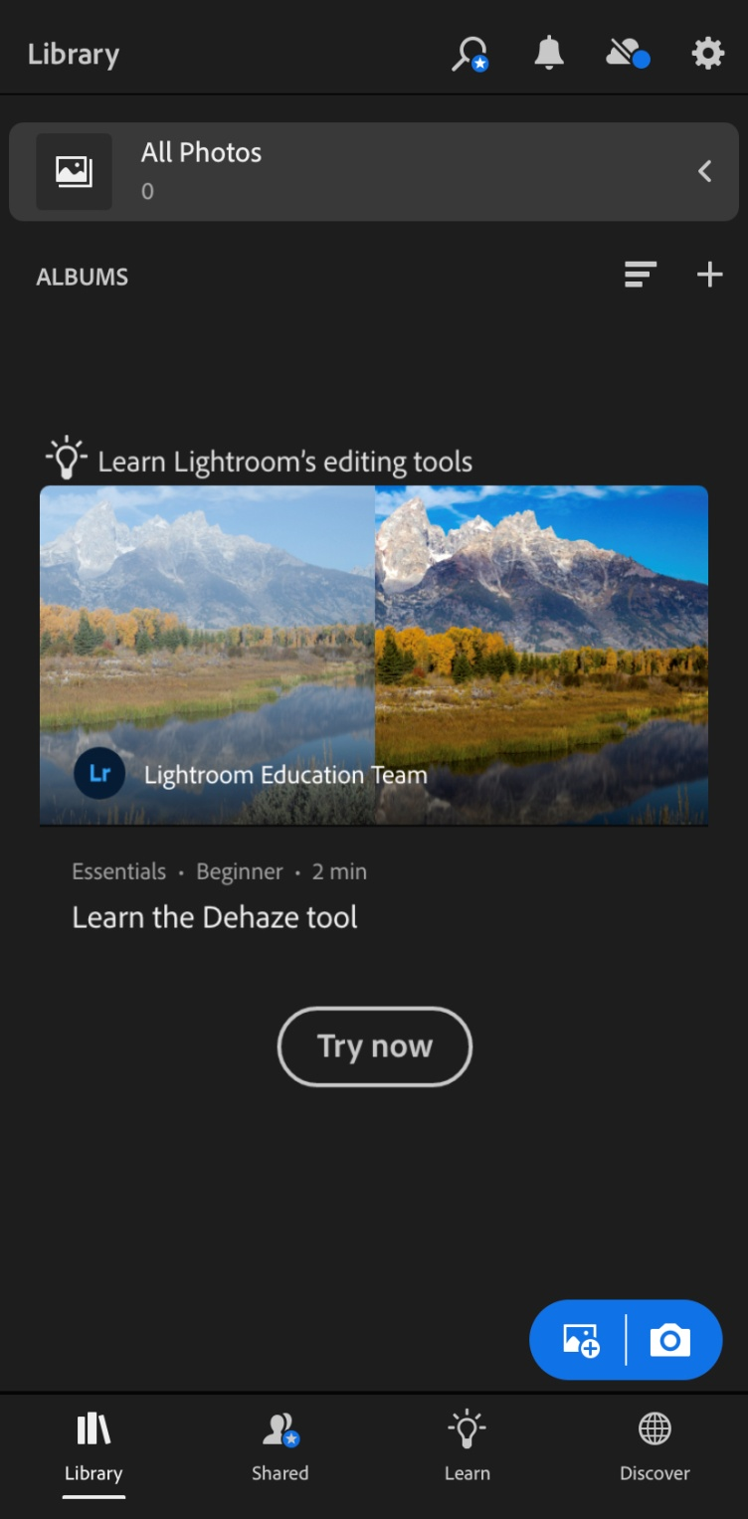
Minimal icons usage with ease of use shows simplicity.
This image is the focal point. It creates emphasis.
It creates a mirror image and both the sides are equally balanced. It shows symmetrical design.
Emphasis on the icon because of the use of blue color.

Slide 3
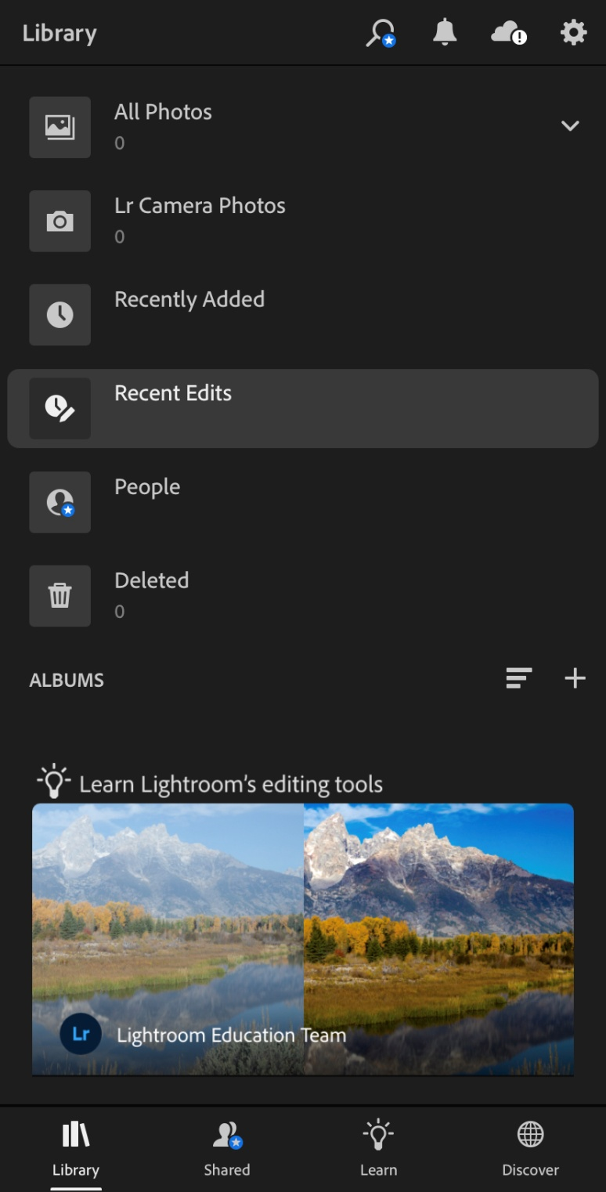
The icons seems to be of same family. It shows unity.
App has made it easy to use with minimal text. The icons are simple and easy to understand. It is showing simplicity.
Showing emphasis by the use of lighter shade on this icon.

Slide 4
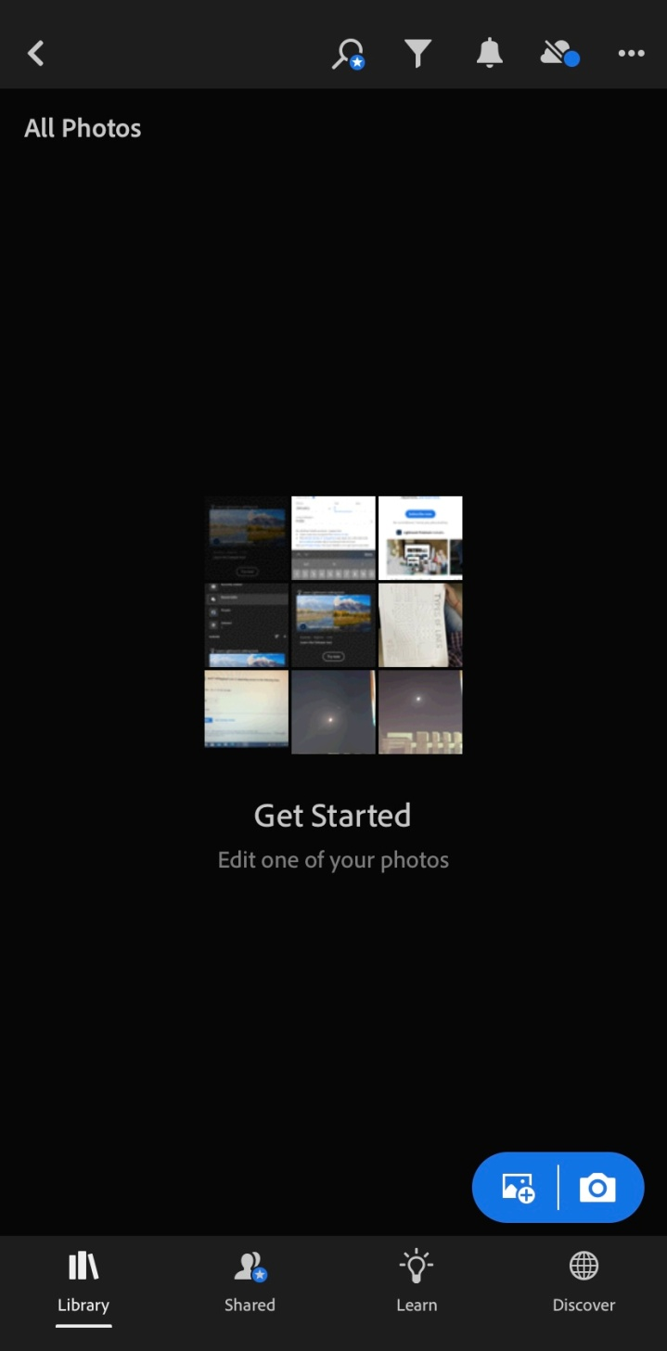
The elements are in rhythm. It is showing the repetition of similar elements of design.
This option for editing photos is the focal point. It creates emphasis.
Minimal use of text showing simplicity.

Slide 5
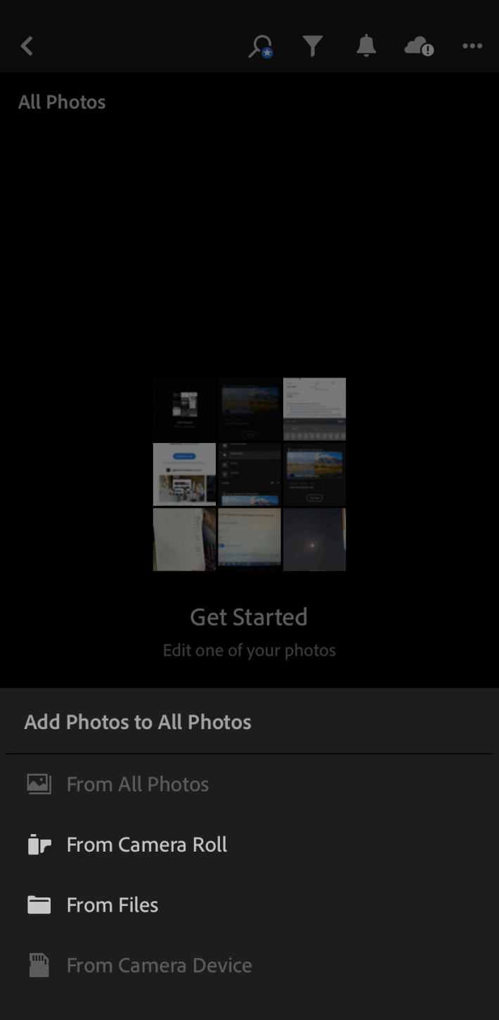
Highlighting the options is putting more emphasis on it.

Slide 6
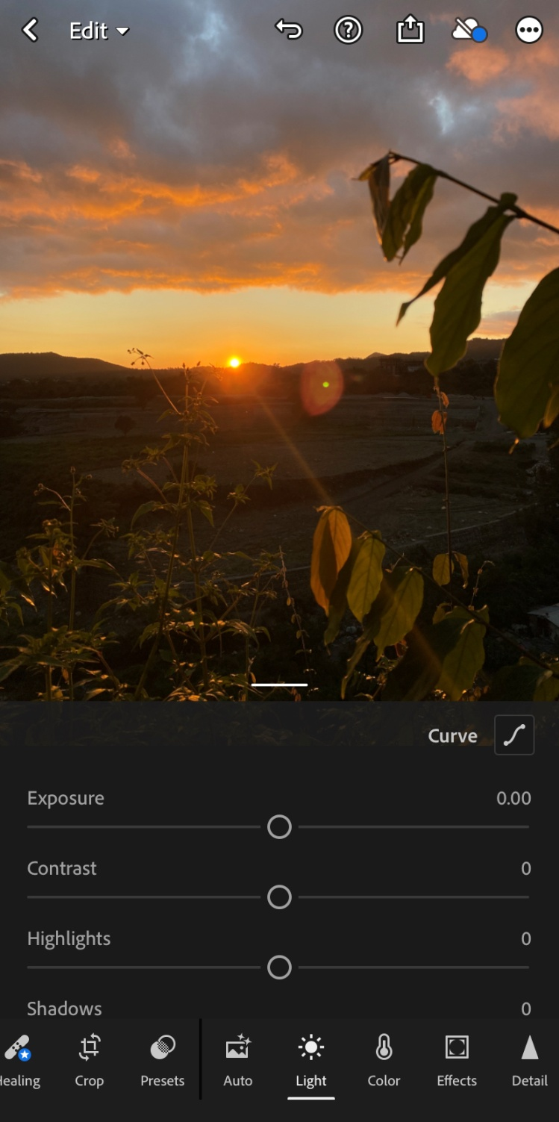
This image is the focal point. It creates emphasis.
The elements are in rhythm. It is showing the repetition of similar elements of design.

Slide 7
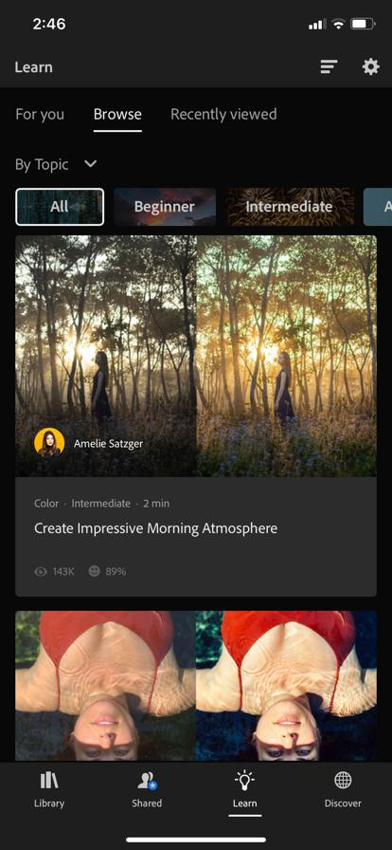
Highlighting the options is putting more emphasis on it.
The element is in rhythm. It is showing the repetition of similar element of design.
It creates a mirror image and both the sides are equally balanced. It shows symmetrical design.
In each tile proportion is the same. The size of each tile is the same.

Slide 8
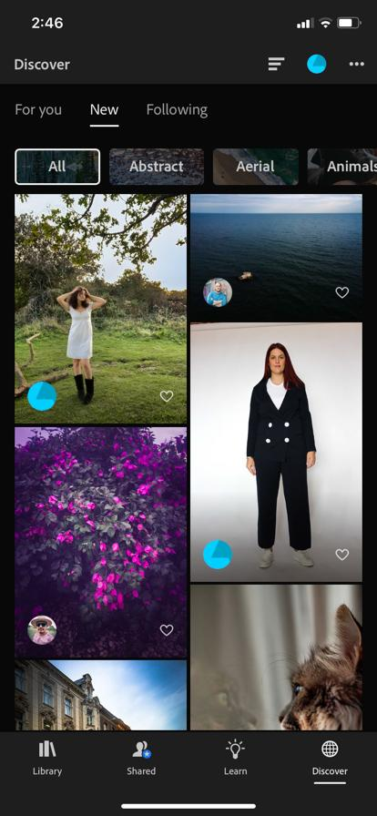
In each tile proportion is the same. The size of each tile is the same.
The elements are in rhythm. It is showing the repetition of similar elements of design.
App has made it easy to use with minimal text. It is showing simplicity.

Slide 9
Thankyou
Name – Alisha Hussain SAP ID - 1000016298

